Slide 1
BUAN 6390 ANALYTICS PRACTICUM
Final Presentation
Group 1 & Group 6

Slide 2
Agenda
Brief recap about our index
Handling missing values - KNN imputation
Changes in our variables
Weighting method 1 & 2
Index visualization
Conclusion
Model selection

Slide 3
RECAP
Sub-index: Education
1175 Census tracts in total
Original 11 indicators: High-quality ECE centers, ECE enrollment, 3rd Reading Proficiency, 3rd Math Proficiency, School Poverty, Adult Education attainment, Student Teacher Ratio, In-married couple families, Free Lunch Ratio, Reduced Lunch Ratio, Title I School.

Slide 4
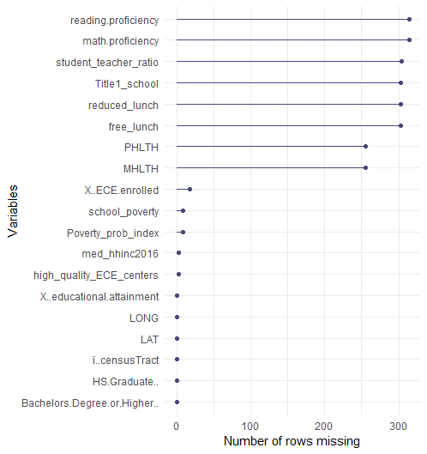
Handling missing values: KNN imputation
There were 11 features and 4 target variables in our dataset that had missing values.
Filtered out tracts with 0 populations and explored the data distribution of each feature using a boxplot which revealed some features had outliers
Features with outliers were imputed with the median while others were imputed with mean of the nearest neighbors.
The values (mean/median) to be imputed were calculated by finding the shortest distance between tracts based on their latitude and longitude.
Used 5 nearest neighbors for our features and used 4 nearest neighbors for target variables based on which the mean/median values were calculated.

Slide 5
Changes in our variables
Added:
High School Graduate %, Some College %, Associates Degree %, Bachelor's Degree % and Graduate Degree or Higher %
Combined into: Bachelor's Degree or Higher % & High School Graduate %
Dropped:
Adult Education attainment

Slide 6
Weighting Method 1 – Simple Linear Regression
Reversed three target variables by multiplying with -1 to ensure higher is better in the target variables.
Poverty_prob_index
Mental health
Physical health
Analyzed outliers using Z-score, set the threshold with 5 to identify outliers.
Figured out there are 12 (1%) outliers in the dataset, however, this is only for the sub-index, if we drop these census tract, there will be missing value when combing final index, so we decided to keep these outliners.
Scaled data by calculating Z-Score for all variabled to ensure the comparable variables.
Z-score = [Xi-mean(Xi)] / std(Xi)

Slide 7
Calculating the weights using simple linear regression
The weight of each sub-indicator is calculated based on the correlation coefficient of sub-indicator with each of the four target variables: Median Household Income, Reverse Poverty Probability Index, Reverse Mental Health, Reverse Physical Health.
The correlation coefficients are obtained from the simple linear regression models, we can avoid the multi-correlation between independent variables, because each time there is only one X variable regressed against one Y variable.
Yi= a + rj*Xi + ei
In order to facilitate this process, we built a LOOP function in Python which help regress each target variable (4) with independent variables (11)

Slide 8
Calculating the weights using simple linear regression
Calculate the average of correlation coefficients (rj)
Rescale average correlation coefficients so that they sum up to the number of indicators: Rj= rj*D/S Where: D is the number of sub-indicators (11) S is the sum of the average correlation coefficients (rj)
Standardize Rescaled average correlation coefficients (Rj): We averaged correlation coefficients with a constant unity-weights and divide the resulting sum by 2. The resulting weights sum up to the number of sub-indicators. Wj= (Rj +1)/2
Final weights: we rescaled the weights so that they sum up to one
Wj/sum(Wj)

Slide 9
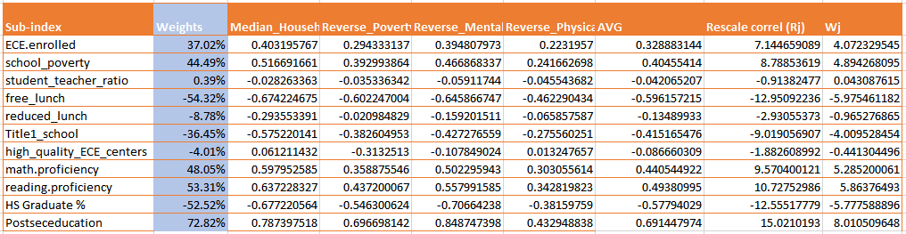
Weights of each sub-indicators using Single Var regression.

Slide 10
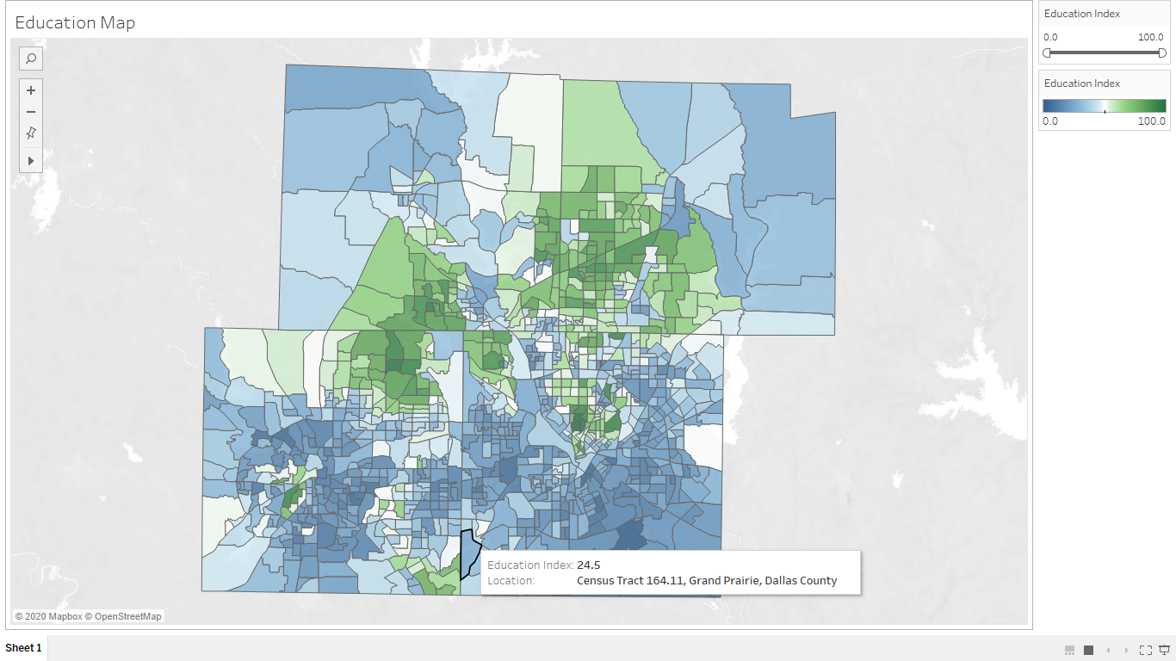
Index Visualization

Slide 11

Weighting Method 2 – Multivariate Regression
Scaled all the variables to get Z score.
Removed outliers before running the regression
Regressed all independent variables with 4 target variables one by one post checking for collinearity
Achieved 70% Rsqr. Removed the non-significant coefficients having P value>.05
Averaged the coefficients from 4 regression to calculated final weight for each coefficient.
Multiplied Independent variables with weights to calculate index.
Scaled the index from 1 to 100 using (X-Min/Range)*100
*Refer "Project summary" for further details

Slide 12
Weights of each sub-indicators using Multi Var regression.
Sub indices | Coefficients | %Weights
ECE.enrolled | 0.019475 | 2%
school_poverty | 0.02285 | 2%
student_teacher_ratio | -0.02008 | 2%
free_lunch | -0.30693 | 28%
reduced_lunch | 0.051275 | 5%
Title1_school | 0.04545 | 4%
high_quality_ECE_centers | -0.0369 | 3%
math.proficiency | 0.05095 | 5%
reading.proficiency | 0 | 0%
HS Graduate % | 0.011 | 1%
Postseceducation | 0.54885 | 49%

Slide 13
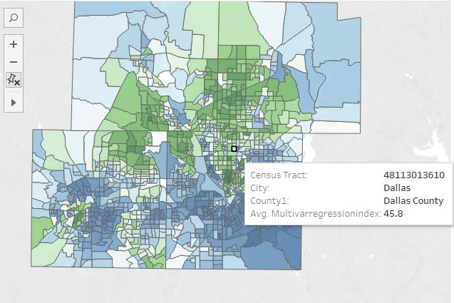
Index Visualization

Slide 14
Index Model selection
SEI=Single Var regression education index
MEI= Multi Var regression education index
Step 1 : F test between SEI and MEI to check the variance.
Result: Variance was not statistically different
Step 2: 2 sample t test with equal variance between SEI and MEI
Result: SEI and MEI are statistically different
Step 3: Compared MEI with other indexes published by other groups Sub-indices ECO INDEX, COMM INDEX, FAMILY INDEX from other group for total absolute average diff as by multiple other research have found that that education is closely correlated with Economic, Community and Family Index.
Result : MEI abs avg difference with other comparative indicators is less compared to SEI and thus MEI was chosen over SEI.

Slide 15
Summary
Post-Secondary education, Reading/Math proficiency, Title1 School and ECE enrollments are positive contributors to Education Index.
High school graduation was expected to contribute heavily to education index but was not the case. Post-secondary education was the biggest contributor instead.
Index can be made more relevant using 2020 Census data.

Slide 16

Thank you!

